Slide 1



Optimization of machine downtime

Slide 2
Contents
Business Objective
Business Constraints
Project Architecture - Data Flow Diagram
Data Collection
Exploratory Data Analysis
Data Visualization
Notes:
Change

Slide 3
Business Problem
Business problem: Machines which manufacture the pumps. Unplanned machine downtime which is leading to loss of productivity.
Business objective: Minimize unplanned machine downtime.
Business constraint: Minimize maintance cost.
Business success criteria: Reduce the unplanned downtime by at least 10%
Economic success criteria: Achieve a cost saving of at least $1M'''

Slide 4
Project Overview and Scope
Overview: This project aims to leverage sensor data, historical maintenance logs, and machine-level insights to proactively identify patterns and signals that precede failure. The objective is to enable predictive maintenance and reduce unplanned outages by at least 10%, without inflating maintenance expenses.
Scope:
The project focuses on predictive analytics and monitoring to minimize unplanned downtime in pump-manufacturing machines, while keeping maintenance costs low. The end goal is a data-driven decision support system that enables early intervention, achieving at least 10% reduction in downtime and $1M in cost savings.
Data: Sensor-based anomaly detection (e.g., vibration, pressure, temperature)
Techniques: Predictive KPIs such as sensor alert rate, failure frequency, and downtime trends
Deliverables: Improve failure prediction accuracy via sensor insights
Impact: Attain at least $1 million in cost savings through improved uptime and production efficiency

Slide 5
Data Dictionary
Colunm name | Column Descripition | Descripition of Levels(If applicable) | Column values understanding | Any additional Details
Date | Timestamp of the observation | Ordinal | Date / Time | Useful for time-series trend analysis, anomaly detection, or finding seasonal patterns in failures.
Machine_ID | Unique identifier for a machine | Discrete (Nominal) | Categorical / String | Helps in tracking historical performance or grouping data per machine for model input.
Assembly_Line_No | Indicates the assembly line the machine belongs to. | Discrete (Nominal) | Categorical / String | Important for location-specific issues or failure clusters in a production area.
Hydraulic_Pressure(bar) | Measures hydraulic system pressure in bar. | Continuous (Ratio) | Numerical / Float | Drop may signal fluid leak or pump degradation, a precursor to failure.
Coolant_Pressure(bar) | Measures coolant system pressure in bar. | Continuous (Ratio) | Numerical / Float | Important for thermal management. Low values can lead to overheating and spindle issues.
Air_System_Pressure(bar) | Continuous measurement in bar units. | Continuous (Ratio) | Numerical / Float | Monitors air pressure in actuators. A sudden drop could cause operation failure in air tools.
Coolant_Temperature | Temperature value in °C. | Continuous (Interval) | Numerical / Float | High values could imply cooling system inefficiency, affecting machine life.
Hydraulic_Oil_Temperature(掳C) | Temperature value in °C. | Continuous (Interval) | Numerical / Float | Rising oil temperature may indicate friction, overload, or blocked valves.
Spindle_Bearing_Temperature(掳C) | Temperature value in °C. | Continuous (Interval) | Numerical / Float | Higher temps = bearing wear, improper lubrication = likely failure.
Spindle_Vibration(碌m) | Micro-vibration of the spindle (in micrometers). | Continuous (Ratio) | Numerical / Float | Spikes here may be early signs of bearing damage or imbalance.
Tool_Vibration(碌m) | Micro-vibration of the tool (in micrometers). | Continuous (Ratio) | Numerical / Float | High vibration could mean tool wear, improper mounting, or imbalance.
Spindle_Speed(RPM) | Speed of spindle rotation (Revolutions per Minute). | quantitative | Numerical / Integer | Used with torque and vibration to infer cutting efficiency or overload.
Voltage(volts) | Voltage supplied to the machine. | quantitative | Numerical / Integer | Voltage fluctuations may damage components or result in failure.
Torque(Nm) | Torque exerted by the machine in Newton-meters. | Continuous (Ratio) | Numerical / Float | Spikes or dips may indicate tool binding or overload conditions.
Cutting(KN) | Cutting force in kiloNewtons. | Continuous (Ratio) | Numerical /Float | High cutting force with high vibration = tool wear or material issues.
Downtime | Indicates if machine failure occurred (Machine_Failure, No_Machine_Failure). | Discrete (Binary) | Categorical / String | Binary classification label—used to predict failure based on all other features.

Slide 6
Exploratory Data Analysis [EDA]
Statistical Insights
Business Insights
Central Tendency & Variability:
* Mean and median differ for many features, indicating skewed distributions.
* High standard deviation and variance in operational metrics show inconsistent machine behavior.
Outliers & Extremes:
* High kurtosis in key variables suggests the presence of extreme values (e.g., sudden long downtimes or spikes in machine load).
* Boxplots confirmed significant outliers, which may represent critical failure points.
Skewness in Data:
* Many numerical features are positively skewed, implying occasional but severe conditions leading to downtime.
Downtime is Not Random:
* Specific assembly lines, shifts, or machine configurations are more prone to unplanned downtime. * These are high-priority areas for intervention.
Outliers Drive Maintenance Costs:
* Machines operating under extreme conditions (load, temperature, pressure) contribute disproportionately to downtime and cost. Monitoring and controlling these can yield savings.
Temporal Trends Exist:
* Downtime events may cluster by month or day, enabling smarter maintenance scheduling and resource allocation.
Notes:
EDA is used for seeing what the data can tell us before the modeling task.
Change

Slide 7
Exploratory Data Analysis [EDA]
Statistical Insights
Business Insights
Feature Relationships:
* Correlation heatmaps revealed strong relationships between machine metrics, indicating possible multicollinearity or interaction effects.
* Bivariate analysis highlighted distinct shifts in variable behavior when downtime occurs.
Categorical Associations:
* Certain categories (e.g., specific Assembly Lines or Machine Types) show higher proportions of downtime, suggesting patterns based on machine setup or process environment.
Predictive Maintenance Opportunity:
* Identifiable patterns in machine metrics before downtime suggest strong potential for a predictive model to prevent failures in advance.
Cost-Saving Potential:
* With targeted improvements and data-driven interventions, the business can realistically reduce unplanned downtime by 10% and achieve >$1M in cost savings—meeting both success criteria.
Notes:
EDA is used for seeing what the data can tell us before the modeling task.
Change

Slide 8
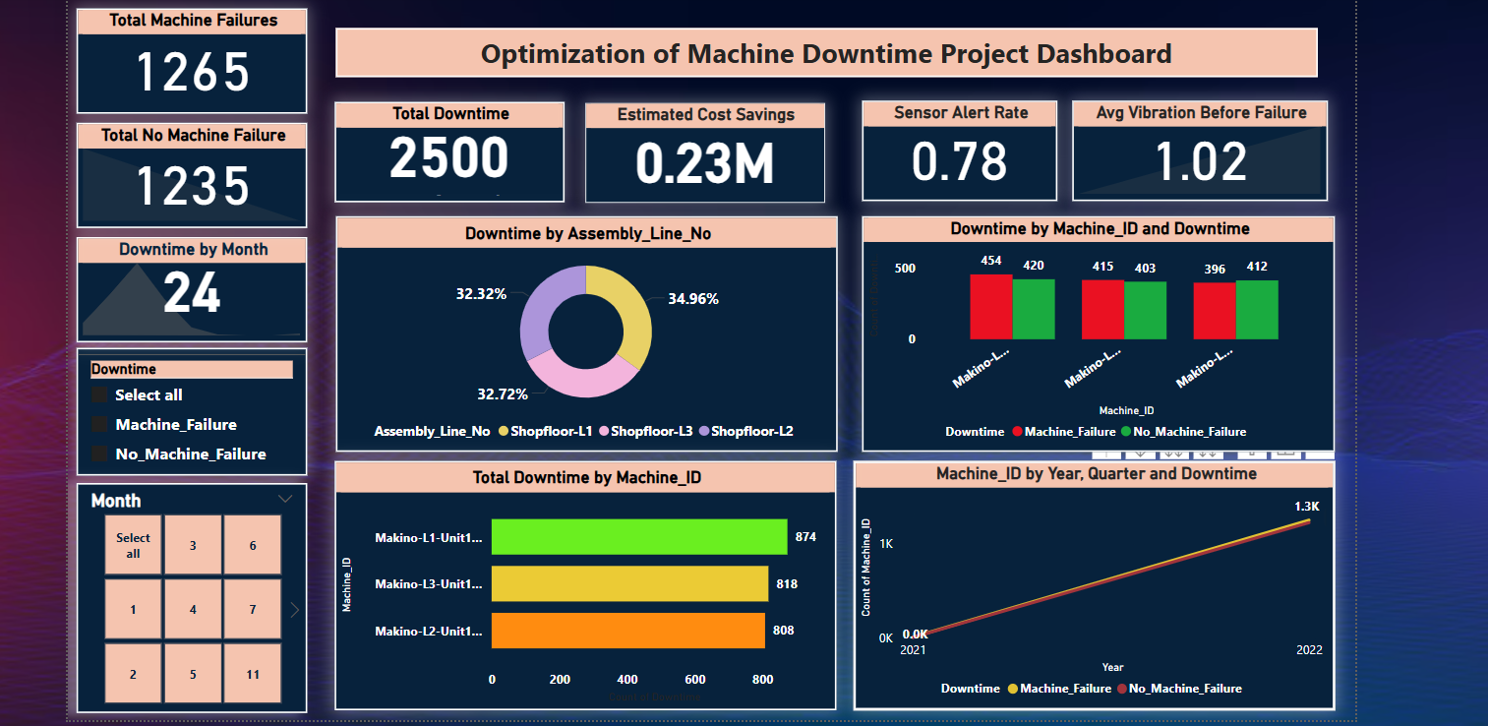
Data Visualization
Notes:
Add graphical

Slide 9


